Slide 1


Exchange Skills, Grow Together
PROJECT
FINAL UPDATE
Neighborhood Skill Exchange
Team: Stack_Overflowed

Slide 2

PROBLEM STATEMENT
Many people have valuable skills they are willing to share, while others are eager to learn. However, finding the right person within the local community is often difficult.
~ No dedicated platform for local skill exchange.
~ Difficulty finding nearby people with specific skills.
~ Existing platforms mainly focus on paid services or online courses.
~ Limited opportunities for community-based learning and collaboration.

Slide 3

PROPOSED SOLUTION
To address these challenges, we propose a community-based web application that connects people who want to teach and learn skills within their local area.
~ Create a user account and build a personal profile
~ Add skills and search for skills offered by mentors
~ Send skill exchange request and complete skill exchange sessions
~ Leave ratings and reviews which build trust through user feedback
~ Encourage lifelong learning and community collaboration
~ Make skill sharing simple, accessible and collaborative

Slide 4


TARGETS & OBJECTIVES
Develop a web-based platform that enables people to teach, learn, and exchange skills within their local community.
Community Learning
User Management
~ Connect learners and mentors.
~ Encourage knowledge sharing.
~ Build a collaborative community
~ Secure registration and login.
~ Create and manage user profiles.
~ Ensure user authentication.

Slide 5


TARGETS & OBJECTIVES
Develop a web-based platform that enables people to teach, learn, and exchange skills within their local community.
Skill Exchange
Trust & Growth
~ Add and manage skills.
~ Search for available skills.
~ Send and manage exchange requests.
~ Ratings and reviews.
~ Improve user credibility.
~ Encourage continuous learning.

Slide 6
SYSTEM FEATURES
LEARNER
MENTOR
~ Mentor search by skill & location
~ Mentor profile & contact unlock
~ Learning request
~ Chat
~ Learning progress
~ Invoice, payment
~ Reviews & rating
~ Store & orders
~ Notification
~ Manage skills & pricing
~ Accept/ reject learners
~ Learning plan and progress
~ One time/ weekly/ monthly billing
~ Invoice generation
~ Earning & balance
~ Withdrawal request
~ Chat & reviews

Slide 7

SYSTEM FEATURES
ADMIN
~ User verification
~ User/ mentor management
~ Skill management
~ Relationship monitoring
~ Payment & revenue monitoring
~ Withdrawal management
~ Store management

Slide 8
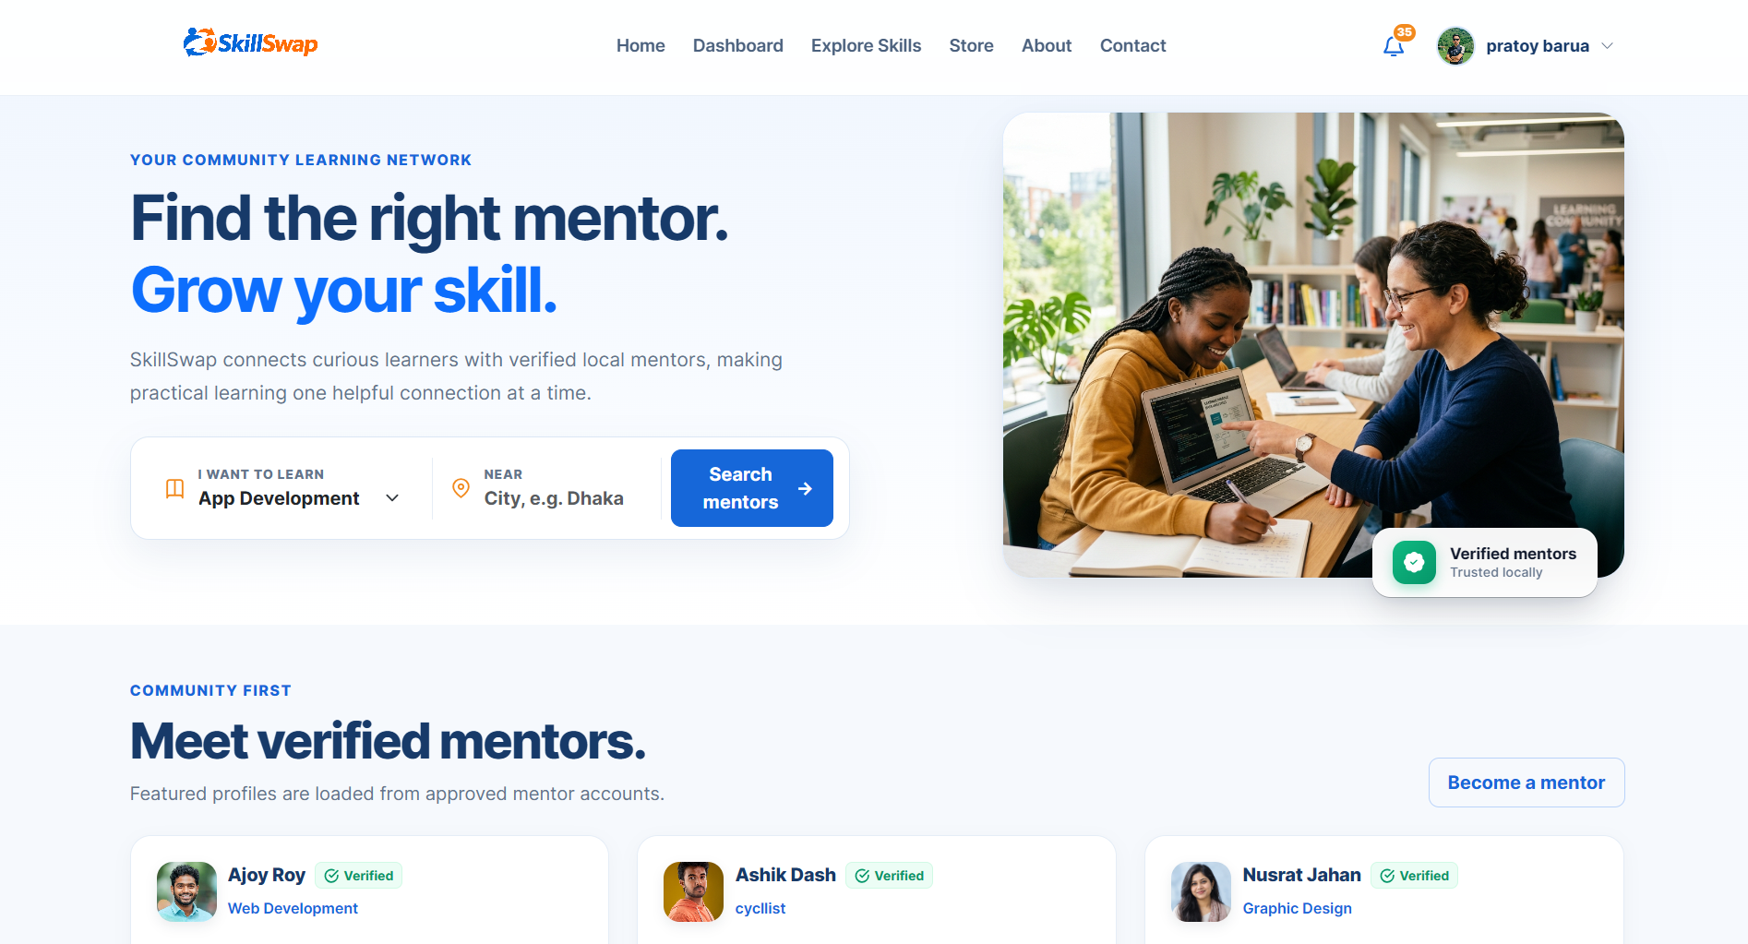
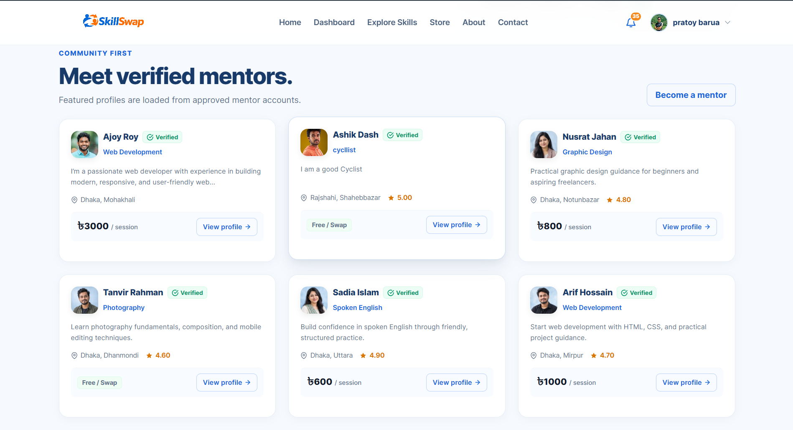
UI SCREENSHOTS

Slide 9
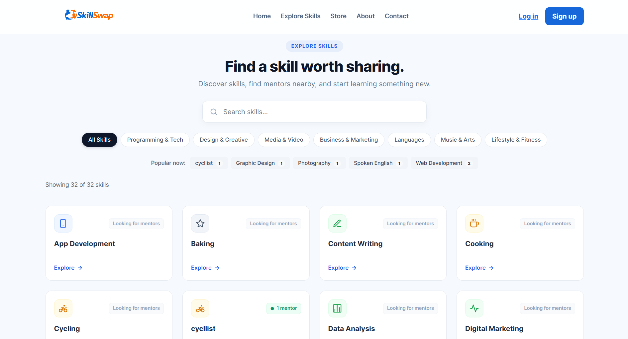
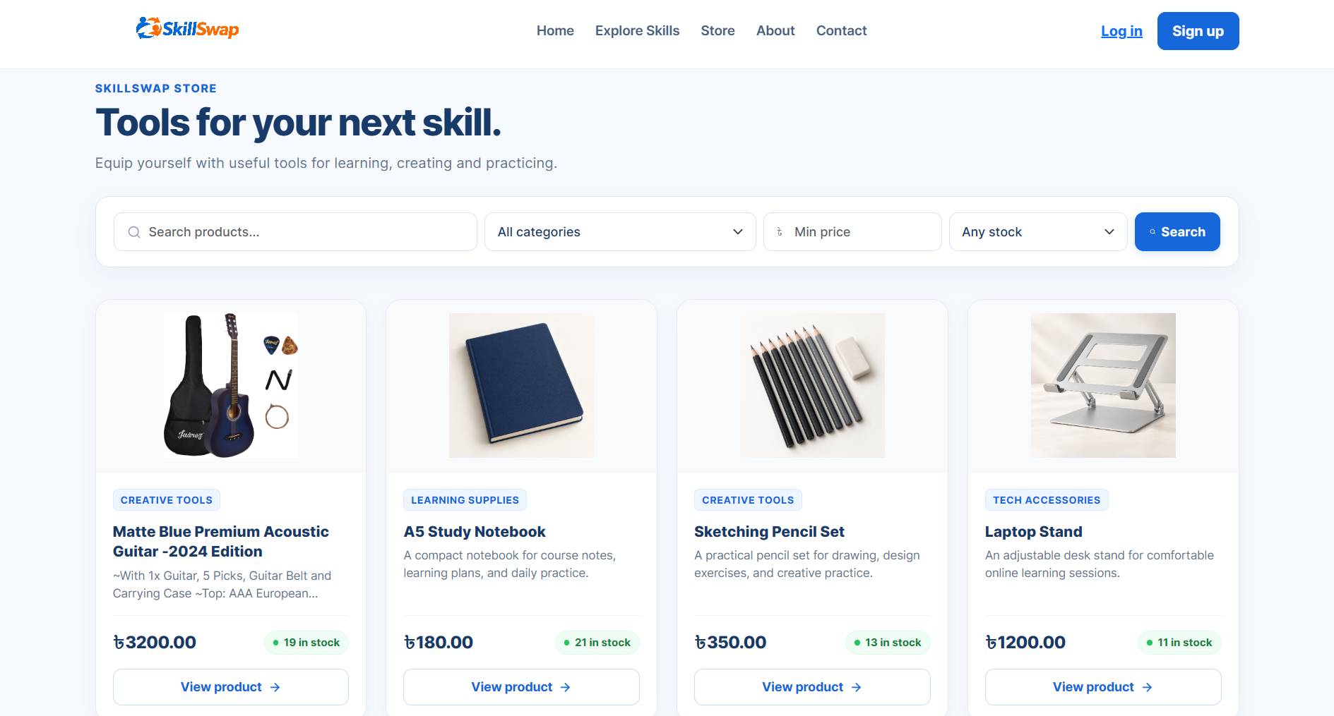
UI SCREENSHOTS

Slide 10
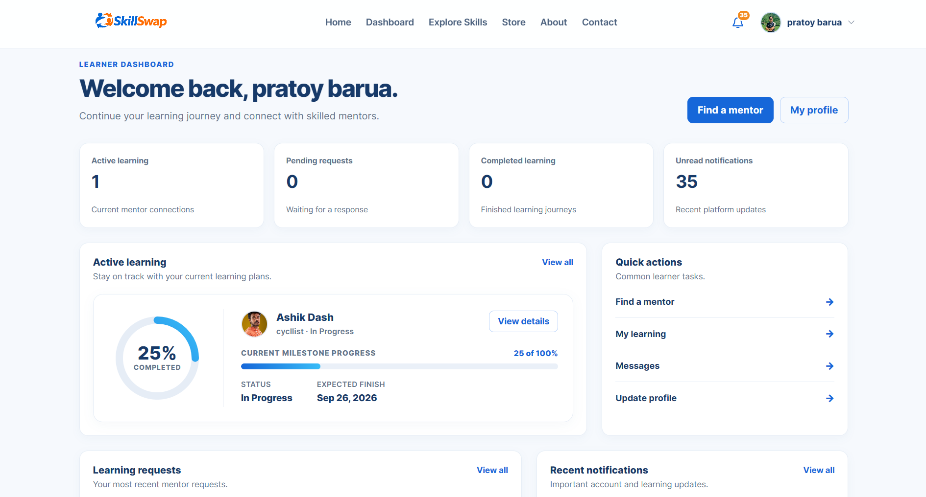
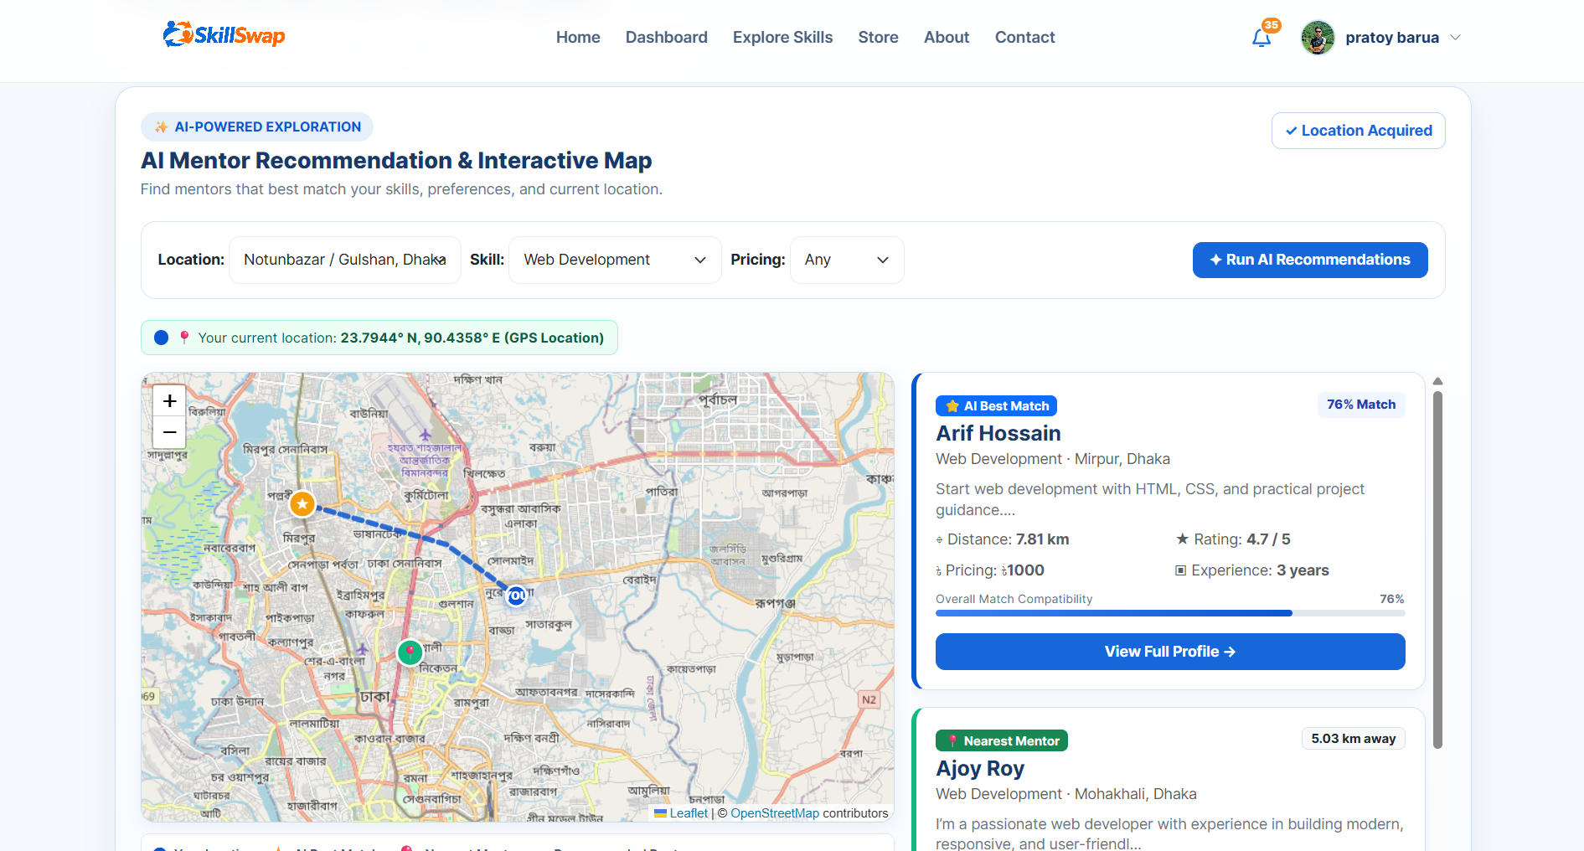
UI SCREENSHOTS

Slide 11
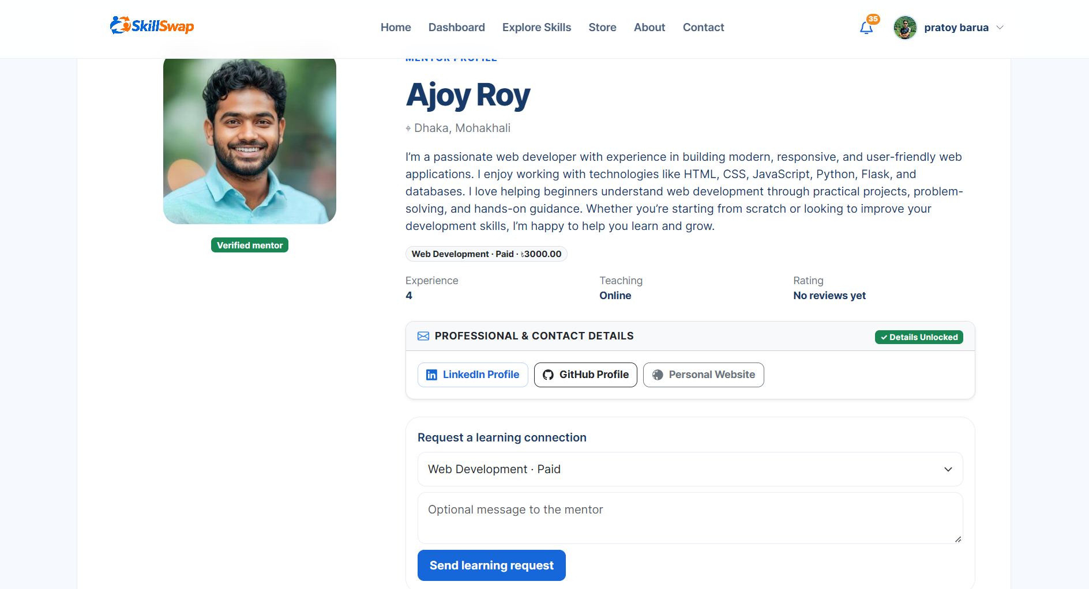
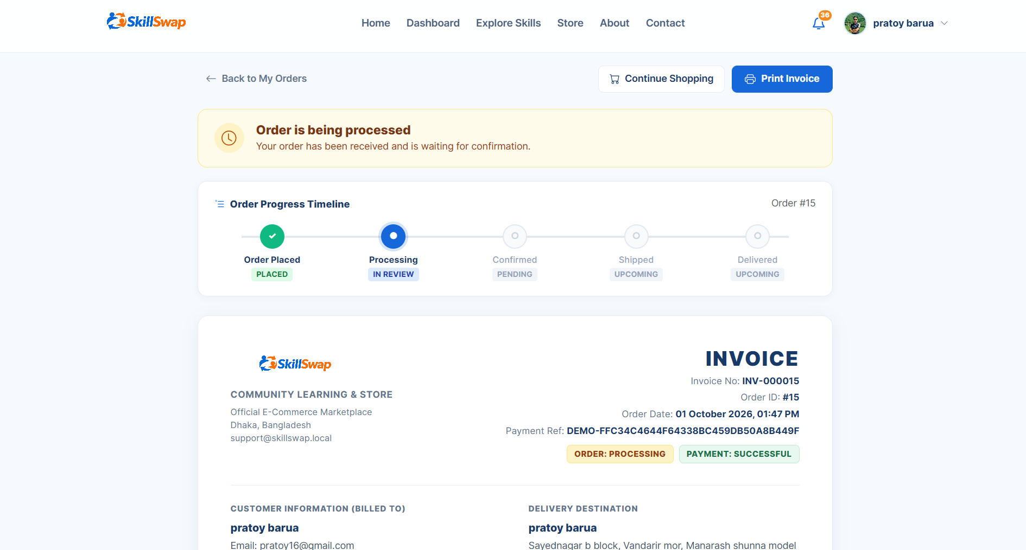
UI SCREENSHOTS

Slide 12
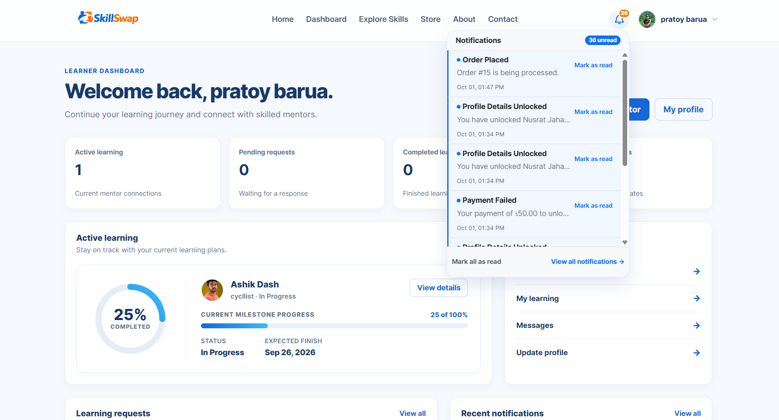
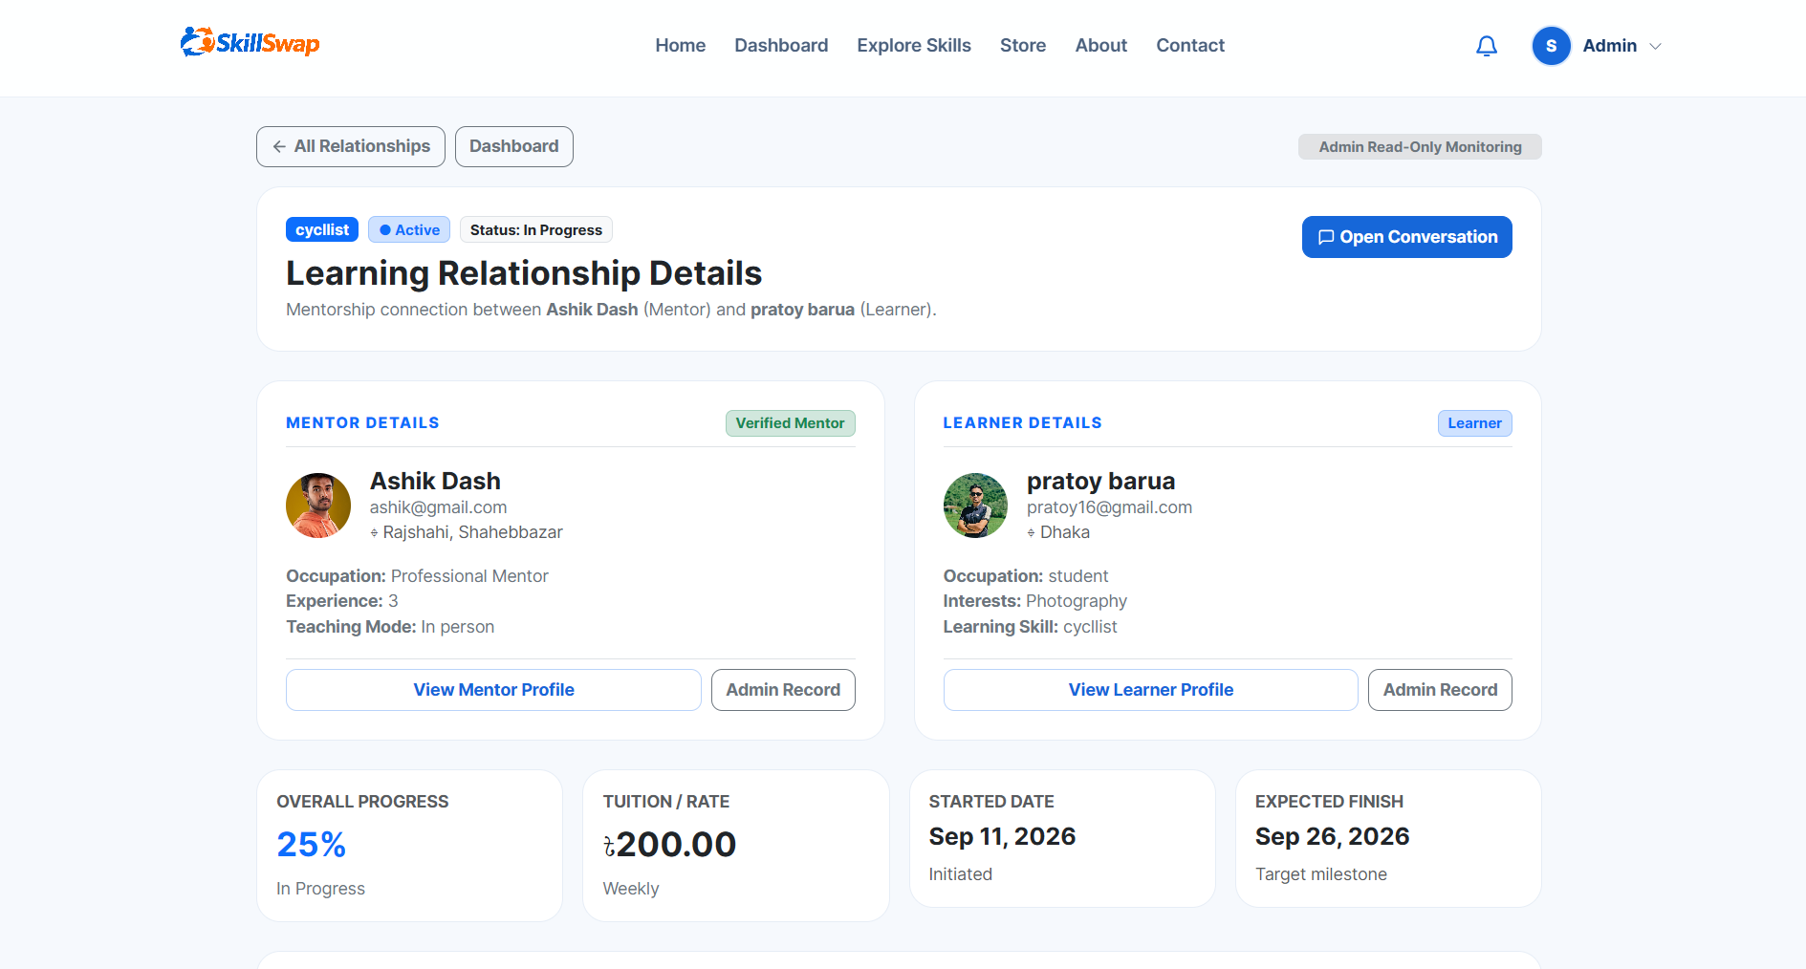
UI SCREENSHOTS

Slide 13
SYSTEM WORKFLOW
Sign up -> Terms & Regulations -> Verification -> Search mentor -> Learning request -> Accept
->
Active
->
Review <- Completion <- Payment <- Invoice <- Chat + Progress
Learning
->

Slide 14
TECHNOLOGY STACK
Layer | Technology
Frontend | HTML, CSS, JavaScript, Bootstrap
Backend | Flask (Python)
Database | MySQL
Version control | Git & GitHub
Containerization | Docker

Slide 15




EXPECTED OUTCOME
Easy Skill Exchange
Community Growth
Find local learners and mentors.
Exchange skills efficiently.
Improve accessibility.
Encourage collaboration.
Share knowledge locally.
Strengthen community connections.
User Satisfaction
Future Ready
Simple and intuitive interface.
Secure authentication.
Reliable rating system.
Scalable architecture.
Store system integration.
Support for future enhancements.

Slide 16


FUTURE PLAN & VISION
Future Plan
Vision
Launch a mobile application (Android & iOS).
Real payment gateway.
Add real-time video learning.
Automated recurring billing.
Build the largest community-driven skill-sharing platform.
Connect learners and mentors across the country.
Promote lifelong learning and knowledge sharing.
Empower individuals through accessible education and collaboration.

Slide 17

BENCHMARK ANALYSIS
Feature |  | MentorHub | Udemy | Superprof
Free Teaching Option | ✅ | ✅ | ✅ | ✅
Paid Teaching Option | ✅ | ✅ | ✅ | ✅
Nearby Mentor Search | ✅ | ❌ | ❌ | Limited
Skill Exchange Between User | ✅ | ❌ | ❌ | ❌
Document Verification | ✅ | ✅ | ❌ | ✅
In-App-Chat | ✅ | ✅ | ❌ | ✅
Rating & Review | ✅ | ✅ | ✅ | ✅
Learning Equipment Store | ✅ | ❌ | ❌ | ❌
Community Based Learning | ✅ | ❌ | ❌ | ❌

Slide 18
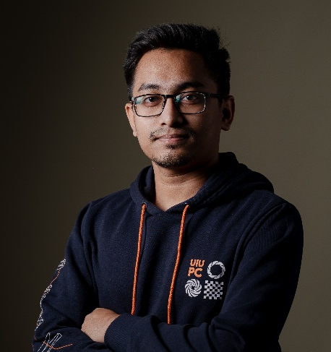

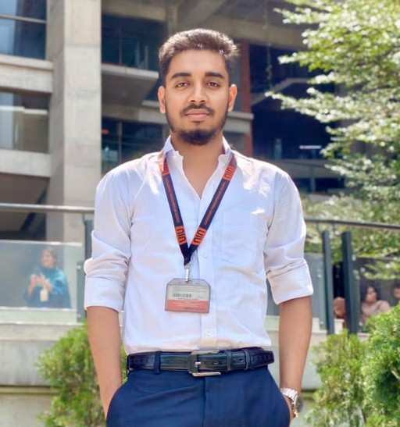
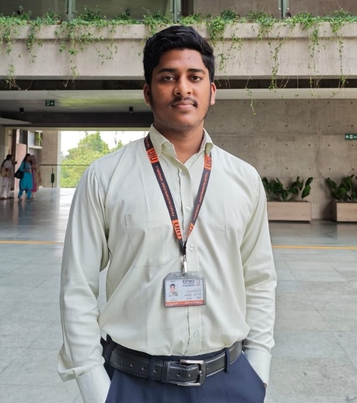
THE MINDS BEHIND
Pratoy Barua
Waled Rahman
Asifur Rahman
MD Rejwan
Backend
Frontend
Documentation
Backend
BACKEND
FRONTEND
DATABASE
DOCUMENTATION

Slide 19
THANK YOU

